Slide 1

Amazon Prime TV Shows and Movies
By Shubham Ingole

Slide 2
Problem Statement
Which Content is Found More in Amazon Prime Movies Or Shows?
In the following category Action, animation, crime, family, Horror and Scifi which is Having the Highest Content?
In which year there is highest release of movies and Shows.?
Which category is having highest number of release in past 10 years, also show the trend line?
Which Type OF Content is Found More As Per Age Certification?
Top 5 Shows Which Has Highest Seasons.
Top Movies and Shows as Per IMDB Rating In INDIA.
Top Movies And Shows BY IMDB Votes.
Data Source- Kaggle

Slide 3

Executive Summary
This analysis report looks at the current market in relation to Amazon Prime Video.
The report includes an overview of the company and analysis of the shows and movies.
IT will help to take Future Decision like which content is what more and which we should fund more in Future to increase the revenue of the company.
Google Drive Link
Tableau Public Project Link- CTR + CICK
Tableau Video Link

Slide 4
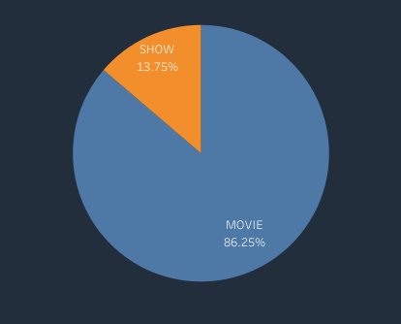
Which content is Found More
AS we Can see the Count of Movies is Greater Than Shows
Shows are Having around 13.75% of Content
Movies are having 86.25 % of Content

Slide 5
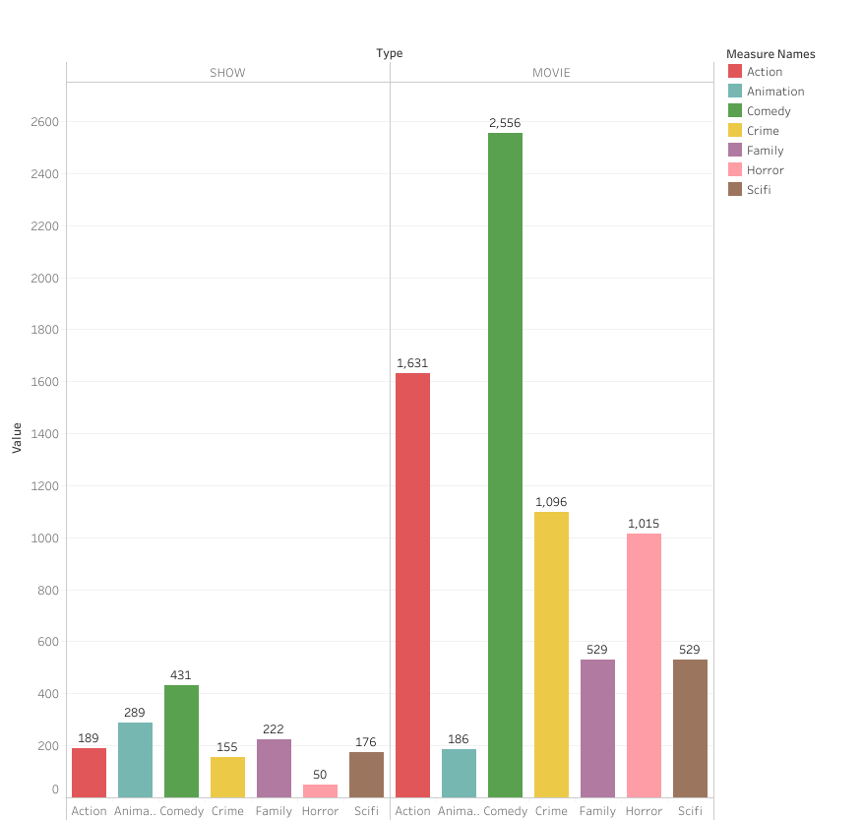
Count Of Different Genres Movies And Shows
In the following category Action, animation, crime, family, Horror and Sci-Fi
The Comedy content is Found more in Movies Followed by Action
When we talk About the shows the Comedy is found more Followed by animation.

Slide 6
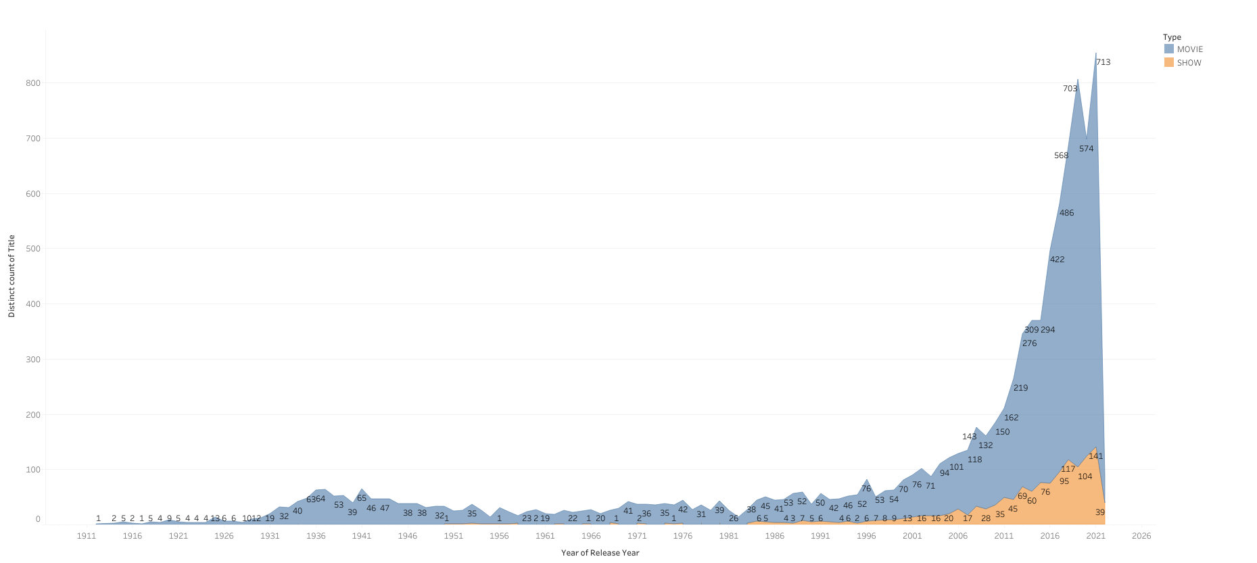
In which year there is highest release of movies and Shows.?
From the Below Graph We can tell there is drastic change in number of movies and shows after year 2000 and
As per the data 2021 was having he max release of movies and Shows

Slide 7
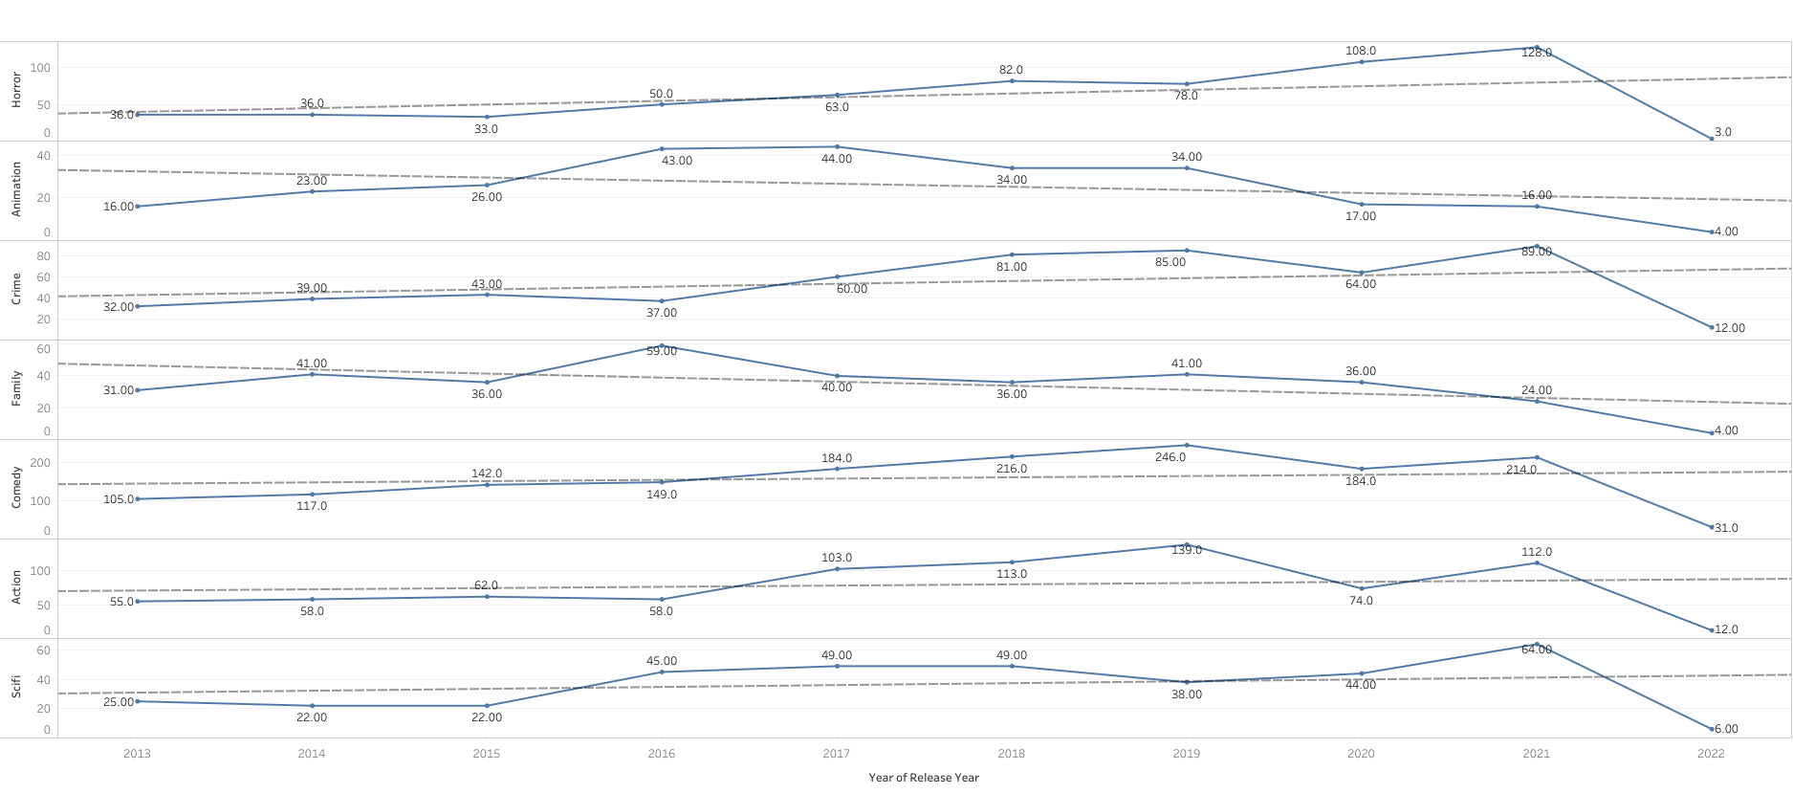
Which Genres is released more in past 10 years?
As per the data we can see the number of Horror and Crime Content is Watch more as compared to all By end of Year 2021.
Whereas Family and animation is Dropping

Slide 8
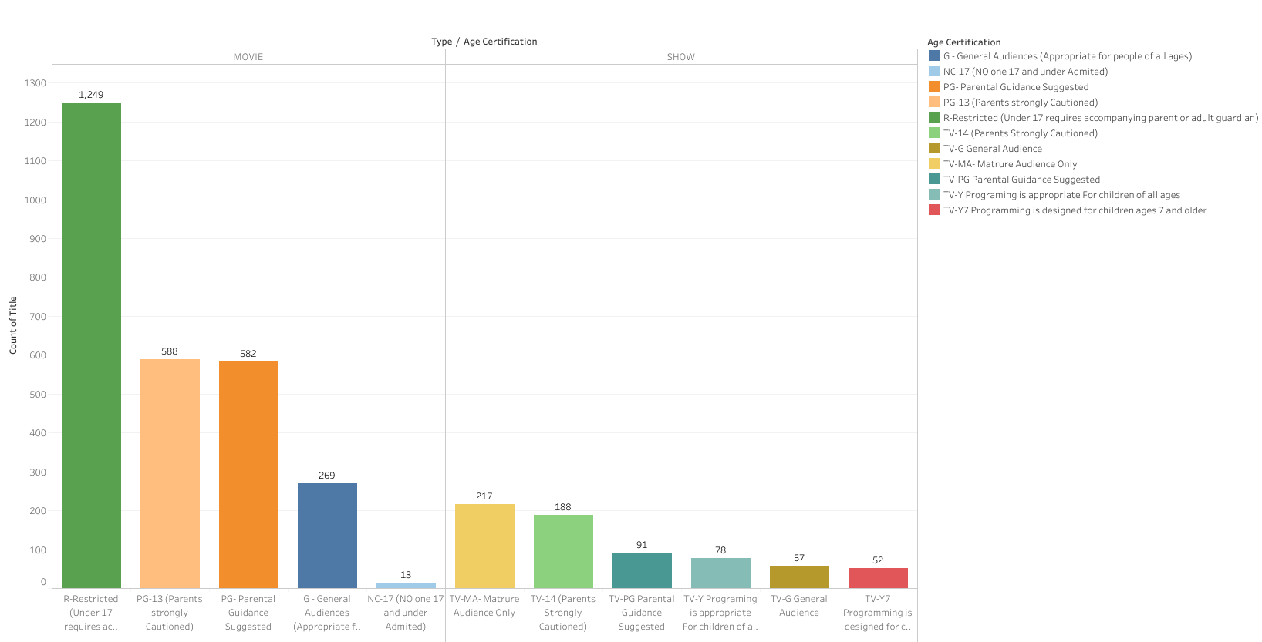
In which Age Category the content is more?
Talking about the Movies the R( Restricted ) content is more and in SHOWS TV-MA (Mature Audience Only) is found more

Slide 9
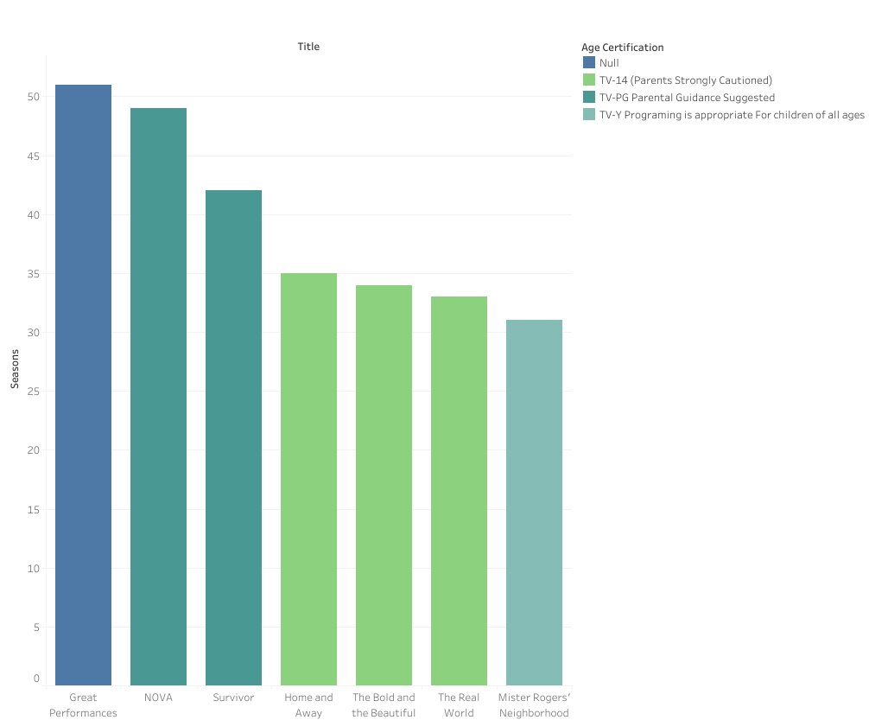
Which Shows have the Highest Seasons
AS per the data the Show “Great Performance” has the Highest number of Seasons

Slide 10
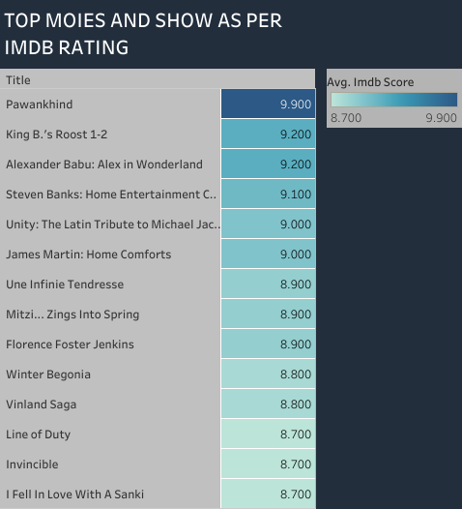
Top Movies and shows as per IMDB rating In INDIA
AS we can see the movie “Pawankhind” in INDIA is Having Highest IMDB Rating

Slide 11
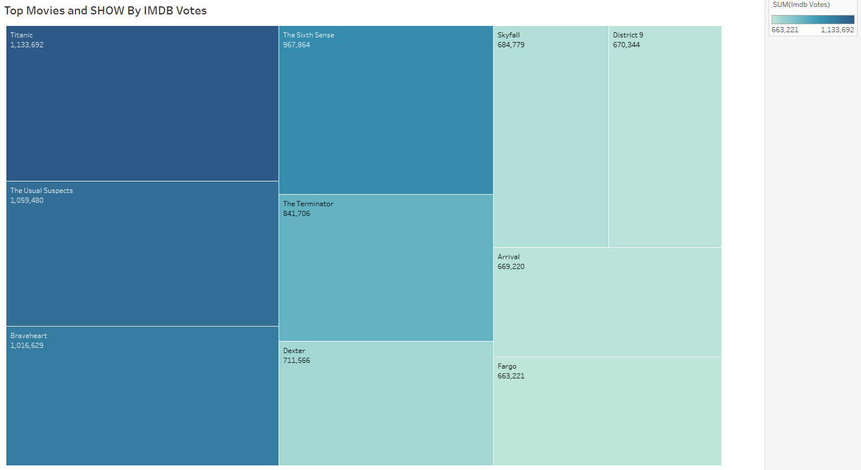
Top Movies and Shows Having Highest No. of IMDB VOTES

Slide 12
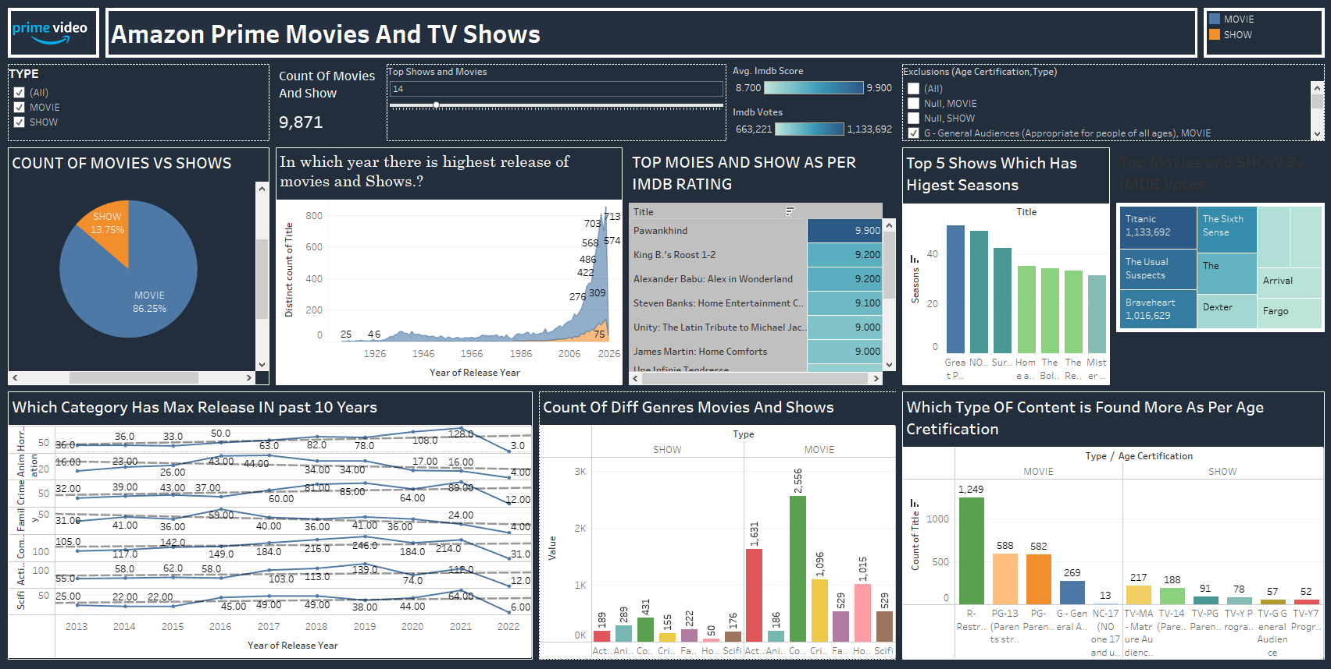

Slide 13
Conclusion
AS per the data Amazon Prime has Grown allot since past few years and by looking at the Visualizations it will rank high against its competitors
The content like Comedy Horror are Growing Day by day new Movies and shows are Getting add.
Restricted and Mature Content is Made more as compare to other age restrictions.

